Slide 1



Slide 2
LAPTOP STORE
PREPARED BY : ABHIJIT .B. WADKAR
ROALL NO : 22BCA003
EXAM NO :
GUIDED BY : SAMIR PATEL
SUBMITTED AS : Partial fulfil of BCA degree 2024-2025
Submitted to: Shri D.N.I.C.A Anand.
Sardar Patel University v. v. Nagar.

Slide 3
TOOLS
Front end – VISUAL STUDIO
Back end – MYSQL
OS - WINDOWS 10
DOCUMENTATION – MICROSOFT OFFICE

Slide 4
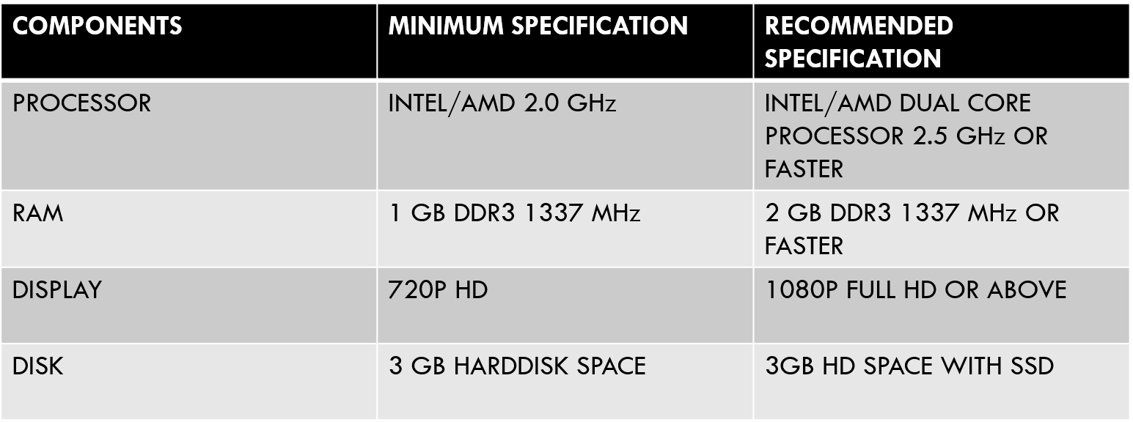
System configuration

Slide 5
SCOPE
This system also helps to store information about their previous sales as secure form and create new sales information. This is the powerful automated system, which will help the management to get various kinds of reports. The system is very fast and user friendly. The scope of the proposed system is bright. This system will prove the best solution for the problems of current system. We have used MYSQL has our back-end tool and visual studio as front-end tool. VS is very powerful for programming purpose and it is easy to use.

Slide 6
EXISTING SYSTEM
The existing system is manual.
All the fine reports are given manually.
The manual system is very slow and time consuming. The existing system contains large number of errors due to manual system. So, we decided to make a computerized system, which is less time consuming and error prone.

Slide 7
NEED OF PROPOSE SYSTEM
Main reasons for the computerization of LAPTOP STORE
Provide services in a better, understandable and cost-effective manner to the user.
To enhance user satisfaction.
Records were stored inefficiently.

Slide 8
Context level
LAPTOP STORE SYSTEM
Product, Make Purchase
Performance Report
CUSTOMER
ADMIN
Product info, order Confirmation
Update product info
Product request
Product receive
WARE HOUSE

Slide 9
ZERO LEVEL
1.0
Customer Registration
Customer register
Info stored
CUSTOMER
ADMIN
Customer info
Product info
2.0
Product&
Order
CUSTOMER
Add To Cart
Product info
Product details
Customer For Order
3.0
Customer Order
order info
Cust_order
Product details
Product info
Customer Product
4.0
Stock
Available
Product info
WAREHOUSE
Requested Product
Inventory_mst
Product request
stock details

Slide 10
FIRST LEVEL
1.1
Login
Cust info
CUSTOMER
Customer info
Cust_mst
Login info
1.2
Add New Customer
New Customer
1.3
Verify
Customer
New Customer
Old Customer
Customer info
old Customer
Customer Product
Check Product Order
Place an Order
Product info
ADMIN
Inventory_mst

Slide 11
SECOND LEVEL
2.1
Payment
Payments info
Store
CUSTOMER
Payment_mst
Bill list
Payment Detail
2.2
Bill Generator
Bill Detail
Final Bill Detail
Database
customer Detail

Slide 12
DATABASE LAYOUT-LOGIN TABLE FOR USER AND ADMIN
1. For Login Detail
Sr No | Field Name | Data type | Size | Constrain | Description
1 | Uid | Varchar | 50 | Primary Key | Username
2 | Pass | Varchar | 50 |  | Password
3 | Design | Varchar | 50 |  | Designation

Slide 13
2. For Customer Information
Sr No | Field Name | Datatype | Size | Constrains | Descriptions
1 | Cust_id | Varchar | 50 | Primary Key | Customer_Id
2 | Cust_name | Varchar | 50 |  | Name of Customer
3 | Contact no | Int |  |  | Contact number
4 | City | Varchar | 50 |  | City of Customer
5 | Laptop Item | Varchar | Max |  | List of Laptop Items
6 | Total Bill | Int |  |  | Total Bill Payment

Slide 14
3. For Available Stock Information
Sr No | Field Name | DataType | Size | Constrain | Description
1 | Item | Varchar | 50 | Primary Key | Name of Items
4. For Intel Laptop
Sr No | Field Name | Database | Size | Constrain | Description
1 | Name | Varchar | 50 | Primary Key | Names of Intel Laptops
2 | Price | Int

Slide 15
5. For Ryzen Laptops
Sr No | Field Name | DateType | Size | Constrains | Description
1 | Name | Varchar | 50 | Primary Key | Names Of Ryzen Laptop
2 | Price | Int

Slide 16
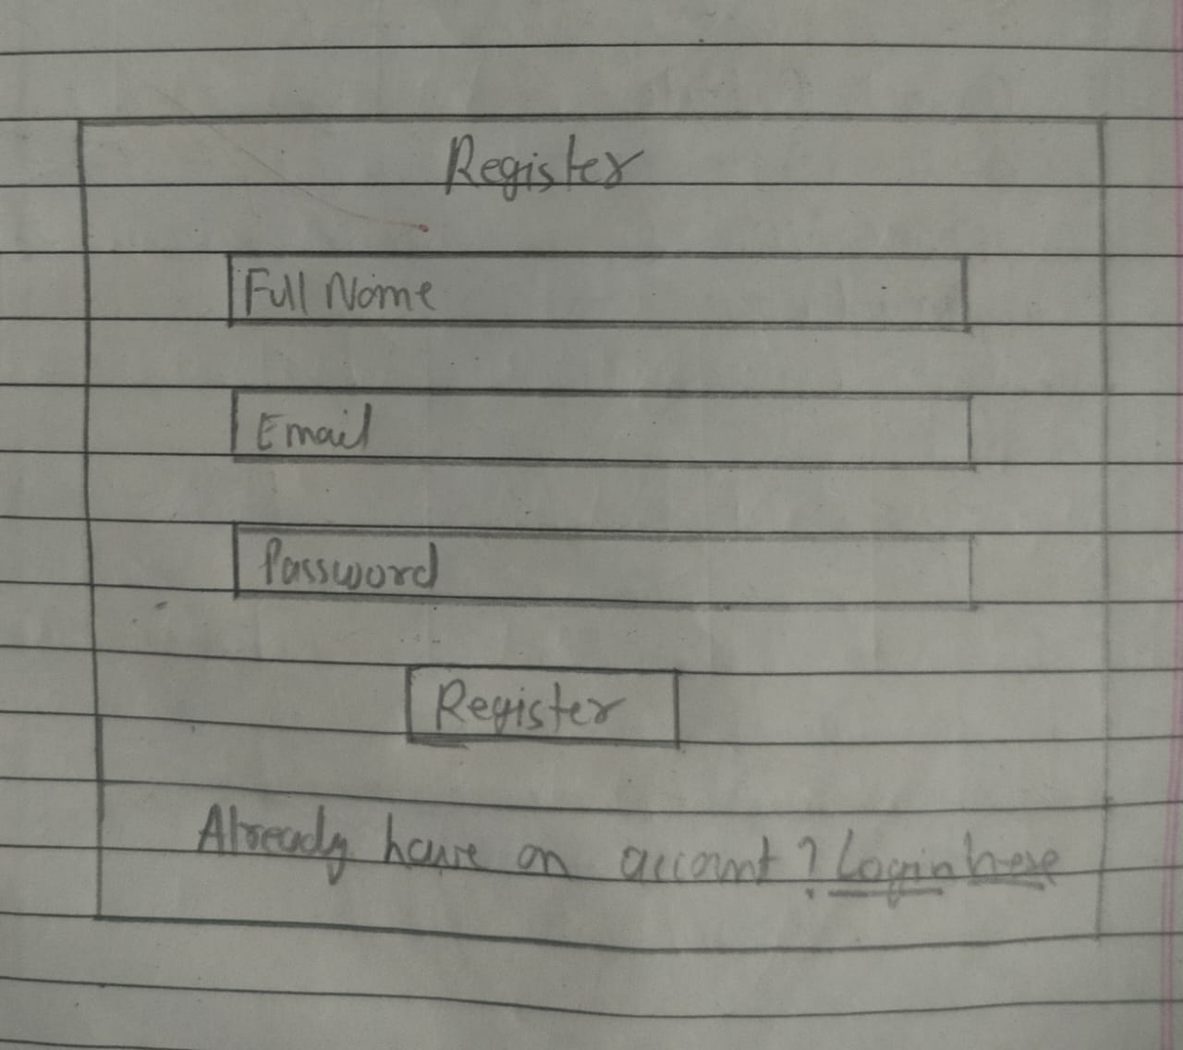

Slide 17
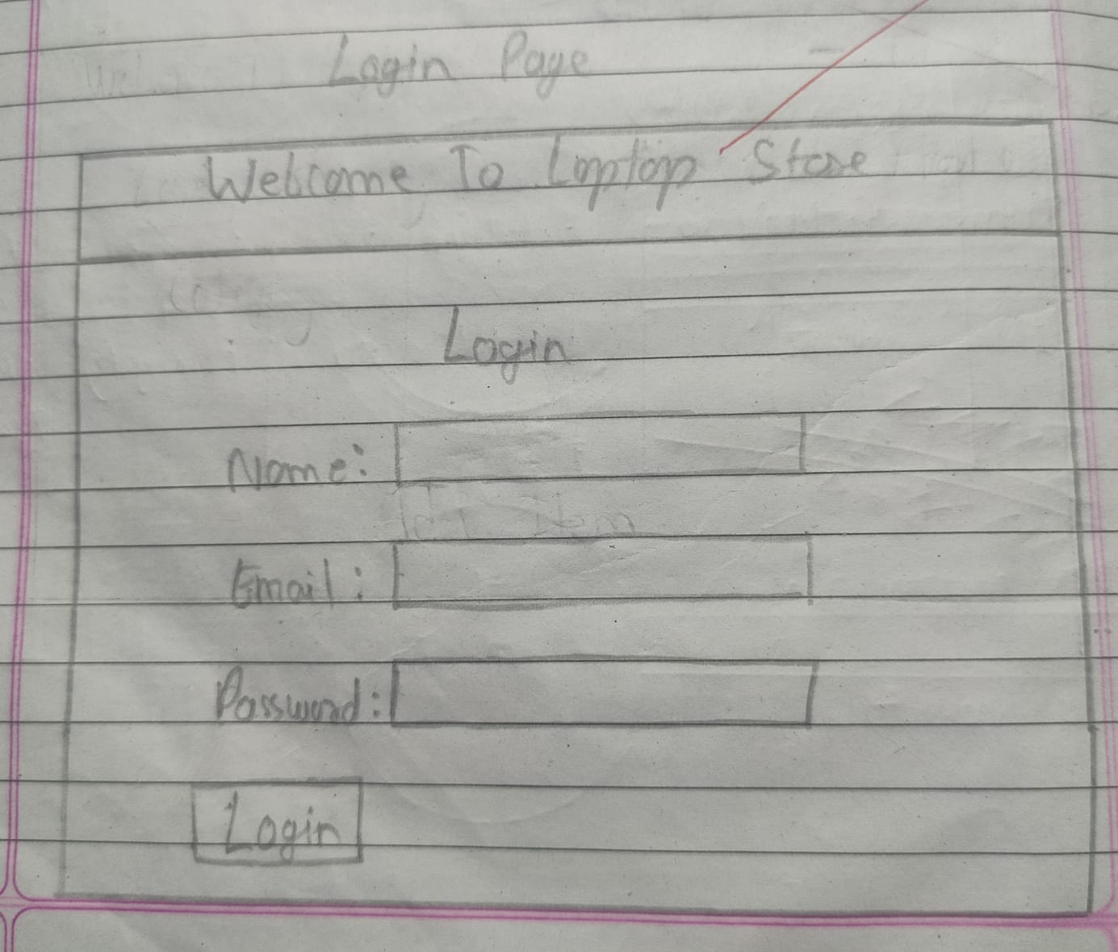

Slide 18
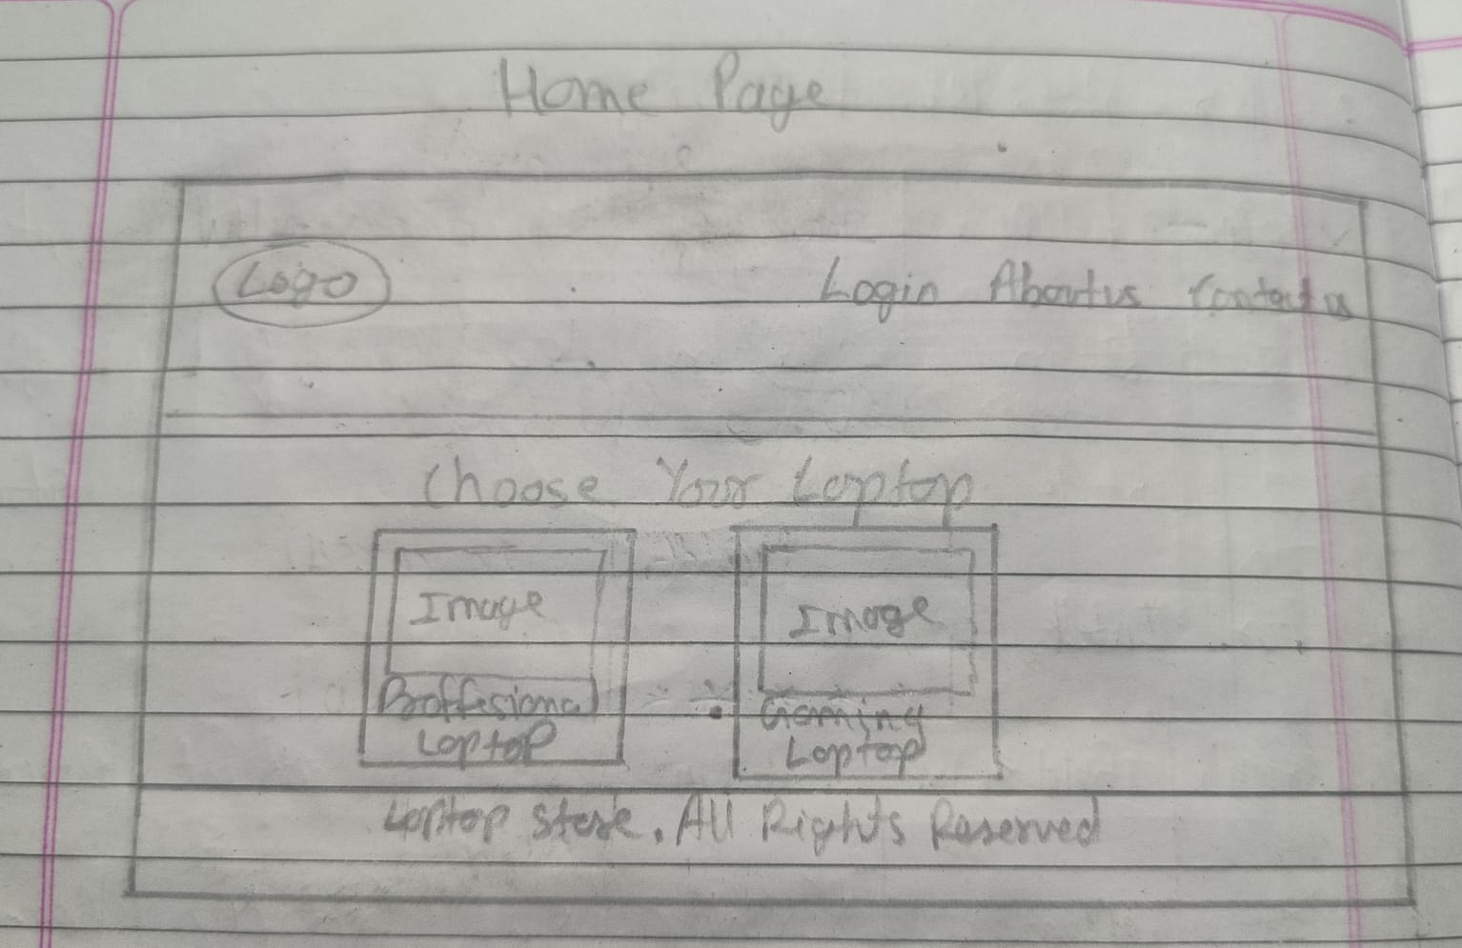

Slide 19
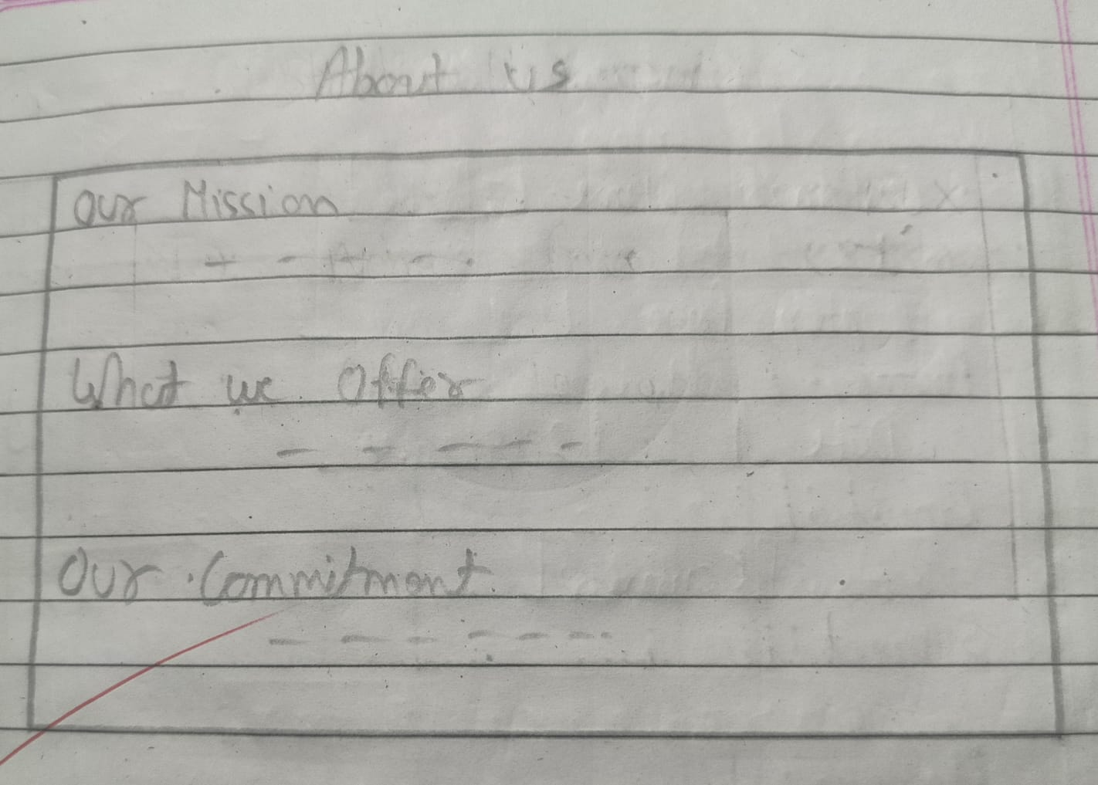

Slide 20
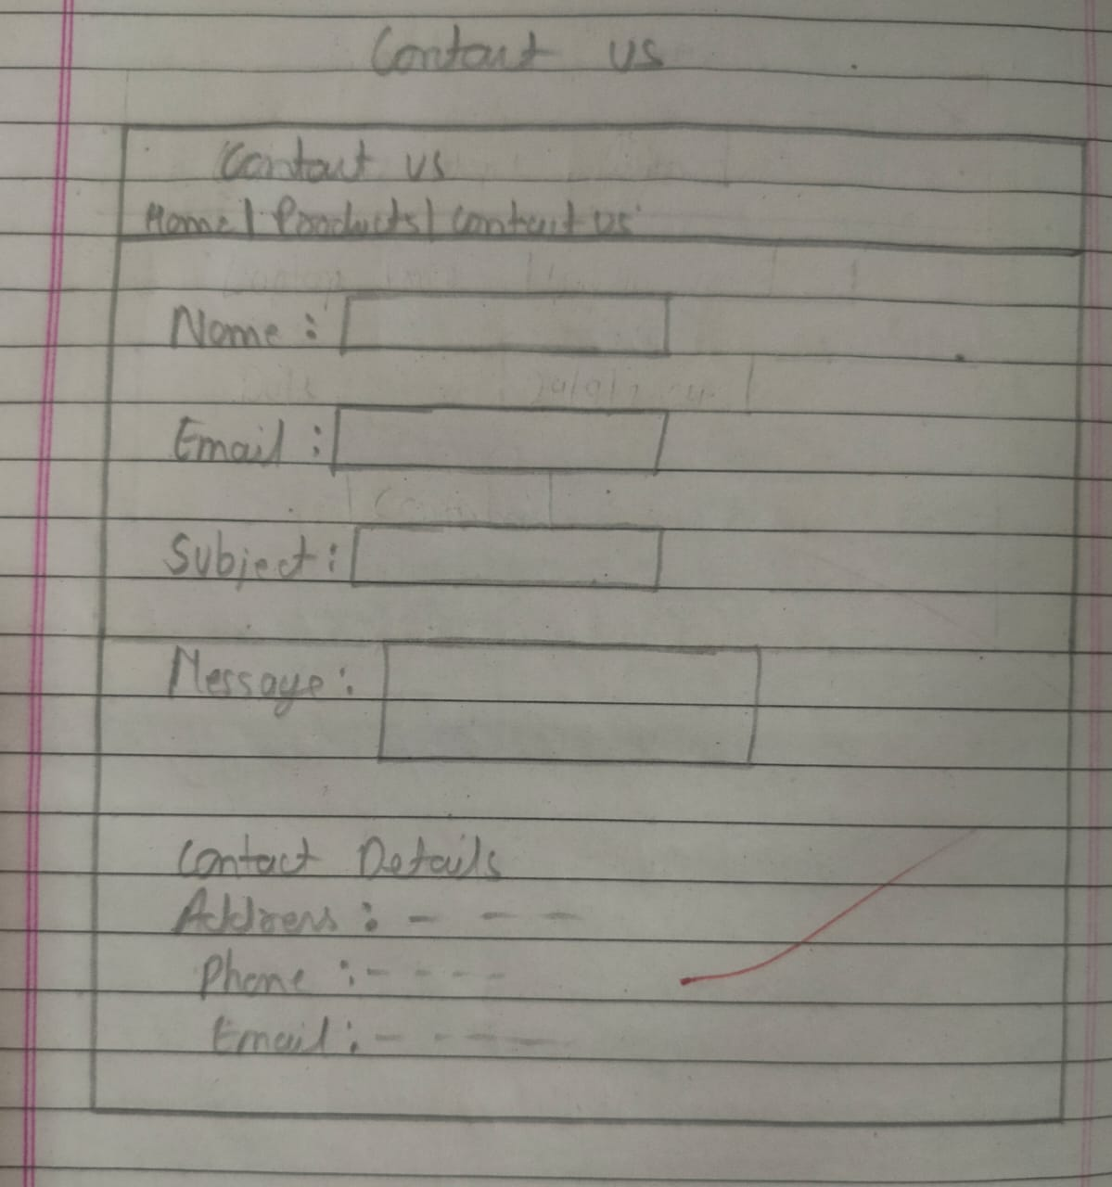

Slide 21
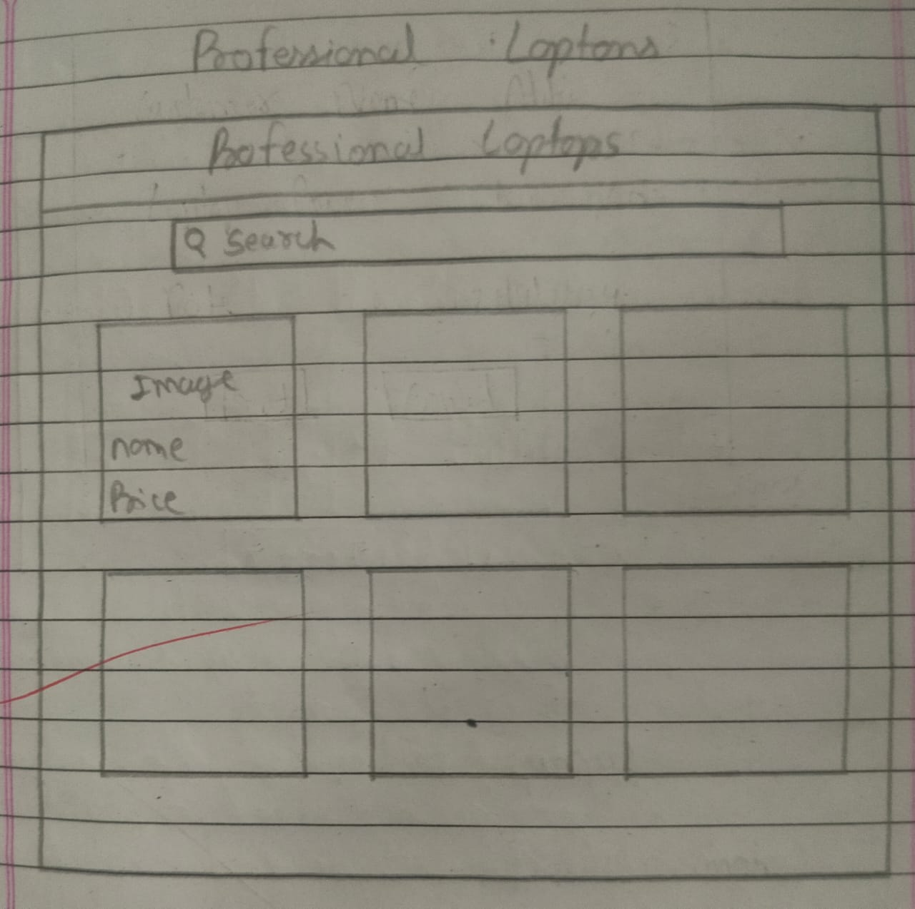

Slide 22
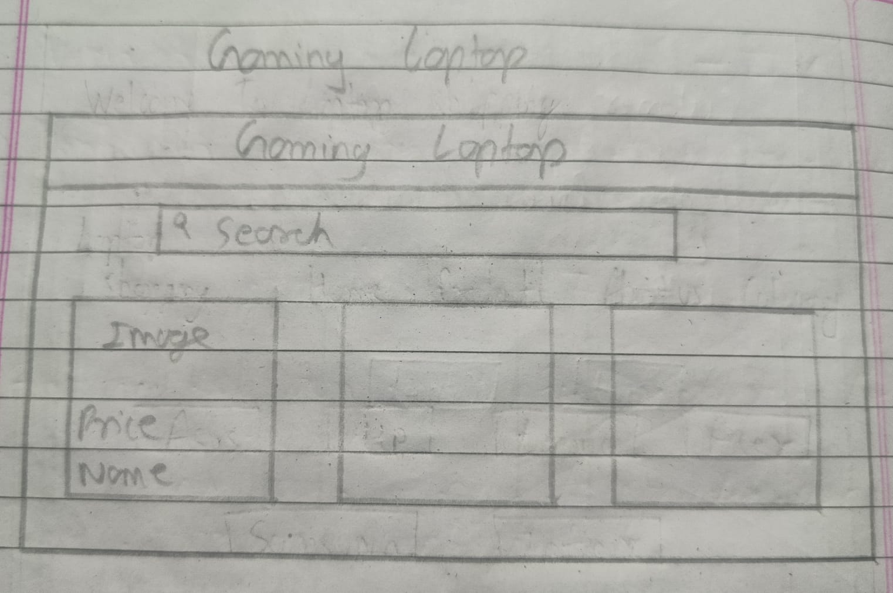

Slide 23
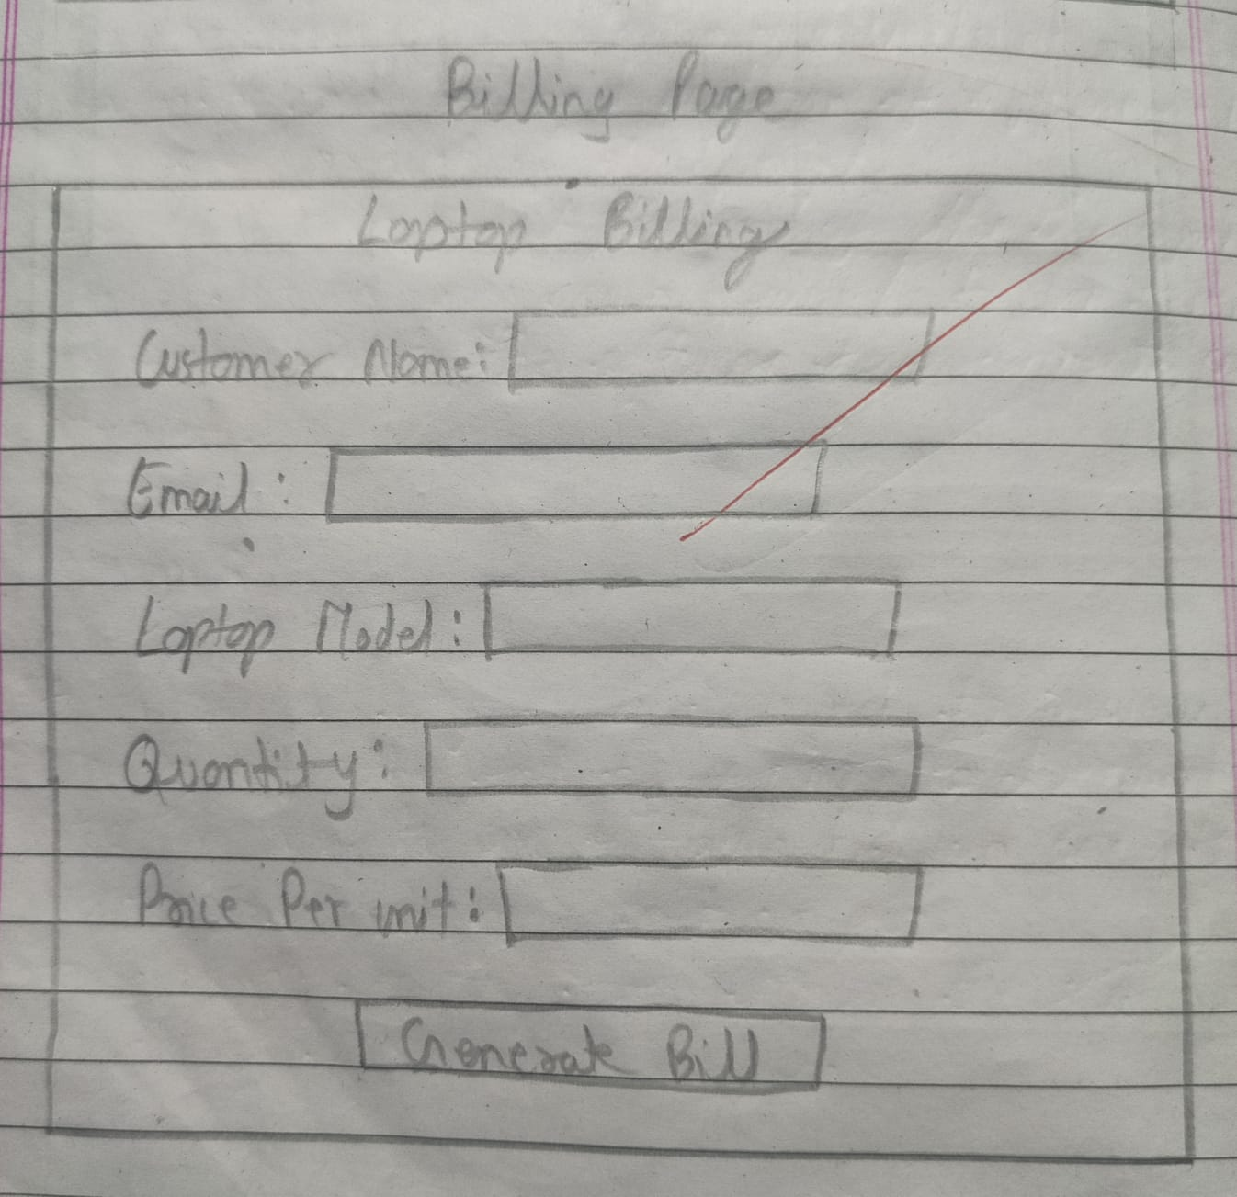

Slide 24
Limitation
User must have computer knowledge.
It is a dot net application hence it requires a windows computer.
User has to deal with large amount of data.
User has to enter data manually.

Slide 25
Conclusion
The Project developed is The Management System for the Rice Technology.
The data of the organisation are kept in a structure manner.
The retrieval, addition and the deletion of the data is much easier.

Slide 26
references
www.google.com
www.slideshare.net
www.freestudentproject.com
www.w3school.com
www.youtube.com
www.diagrams.net

